Slide 1



Ethics in IT
Class X
lab 2

Slide 2

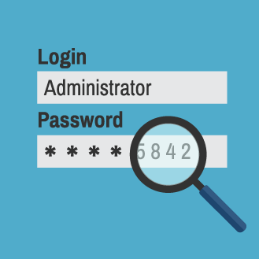
Password Hacking
Password hacking, sometimes referred to as password cracking, is a method of recovering passwords from data transmitted by or stored on a computer

Slide 3
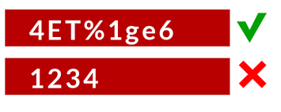
Strong Password Contains
At least 8 characters
A mix of letters, numbers, and special characters
A combination of small and capital letters

Slide 4

Dictionary Attack
In a dictionary attack, the hacker uses a predefined list of words from a dictionary to try and guess the password

Slide 5
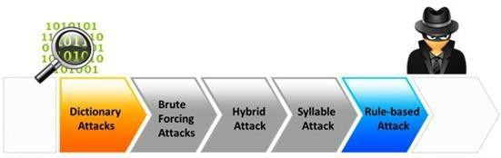
Hybrid Dictionary Attack
a set of dictionary words combined with extensions

Slide 6
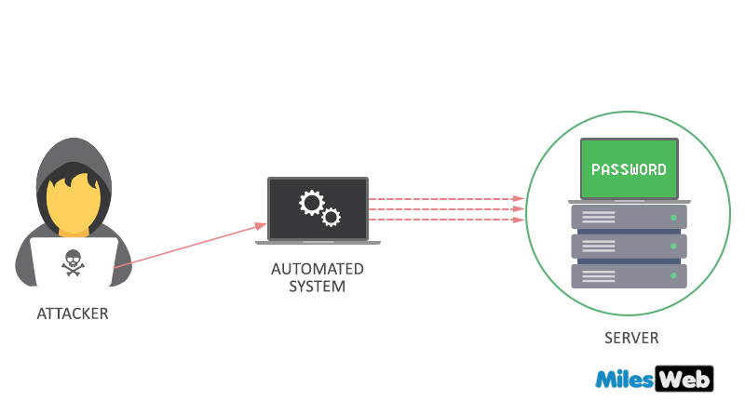
Brute-Force Attack
the hacker uses all possible combinations of letters, numbers, special characters, and small and capital letters to break the password

Slide 7
Rainbow Tables
A rainbow table contains a set of predefined passwords that are hashed

Slide 8



